Slide 1
Intro to Java Programming
Let’s Get Practical

Slide 2
Inheritance
Mechanism in which one class (child/sub class) acquires all the properties and methods of a another class (parent/super class)
Student
Bachelors
Masters
Doctorate
Notes:
The idea behind inheritance in Java is that you can create new classes that are built upon existing classes. When you inherit from an existing class, you can reuse methods and fields of the parent class. Moreover, you can add new methods and fields in your current class also

Slide 3
Why Inheritance?
Code Reusability
Method Overriding (Important in Polymorphism)

Slide 4
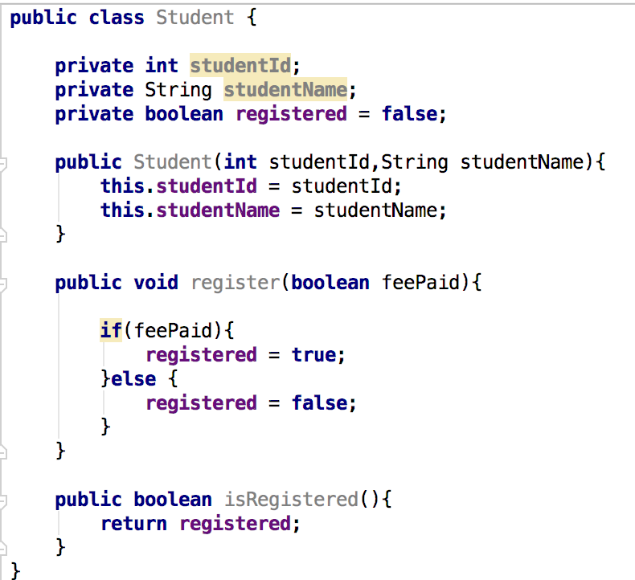
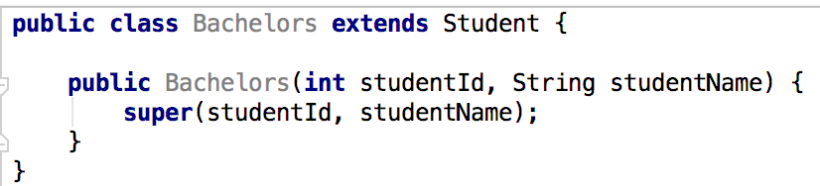
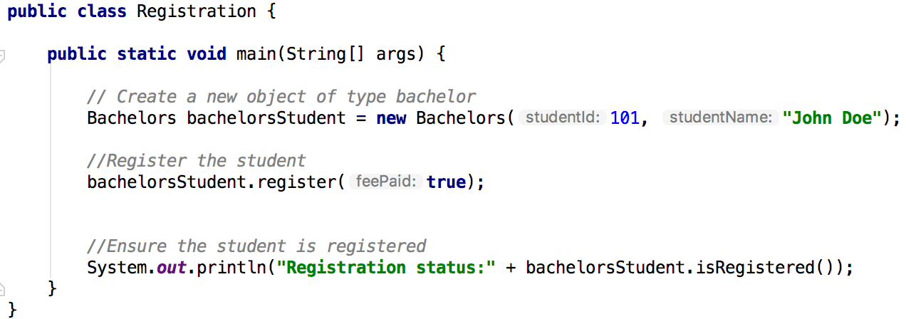
Inheritance Syntax

Slide 5
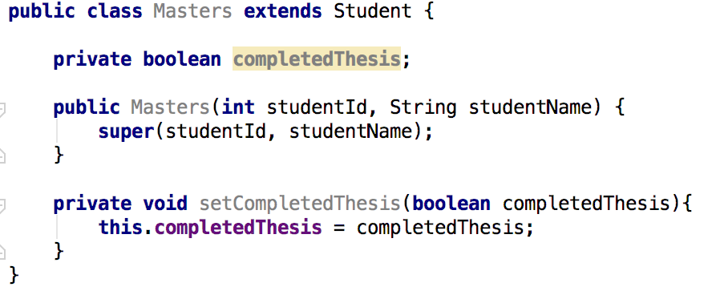
Inheritance Syntax

Slide 6
Types of Inheritance
Class A
Class A
Class A
[Animal]
[Animal]
[Animal]
Class B
Class B
[Dog]
[Dog]
Class B
Class C
[Dog]
[Cat]
Single
Hierarchical
Class C
[Puppy]
Multilevel

Slide 7
Polymorphism
Mechanism by which we can perform a single action in different ways
Two key concepts that implement polymorphism
Method overriding
Method overloading

Slide 8
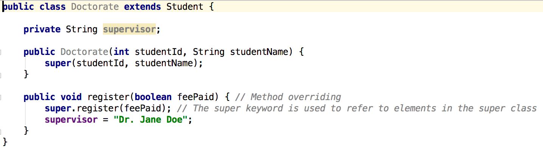
Method Overriding
Overriding: change the implementation details of a method from the parent class

Slide 9
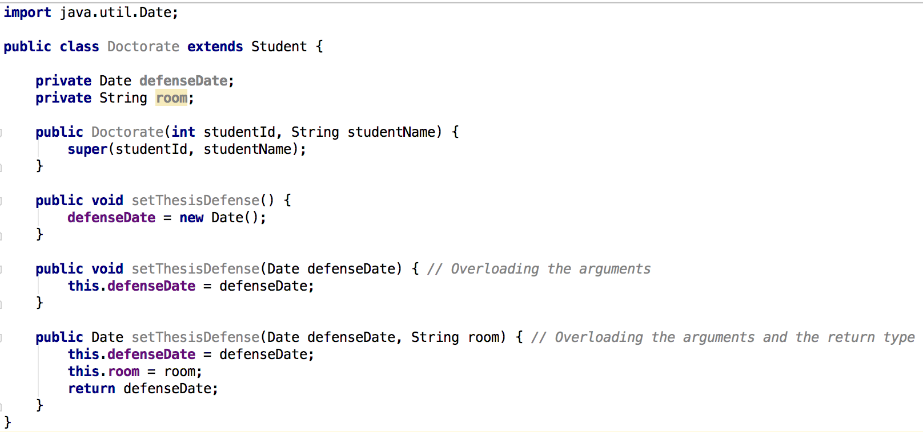
Method Overloading
Overriding: change the definition details of a method in the same class

Slide 10
Debugging
Process of finding the cause of errors in code
Two main kinds of errors:
Syntax: Incorrect grammar in your code
Logical: Incorrect flow in your code

Slide 11
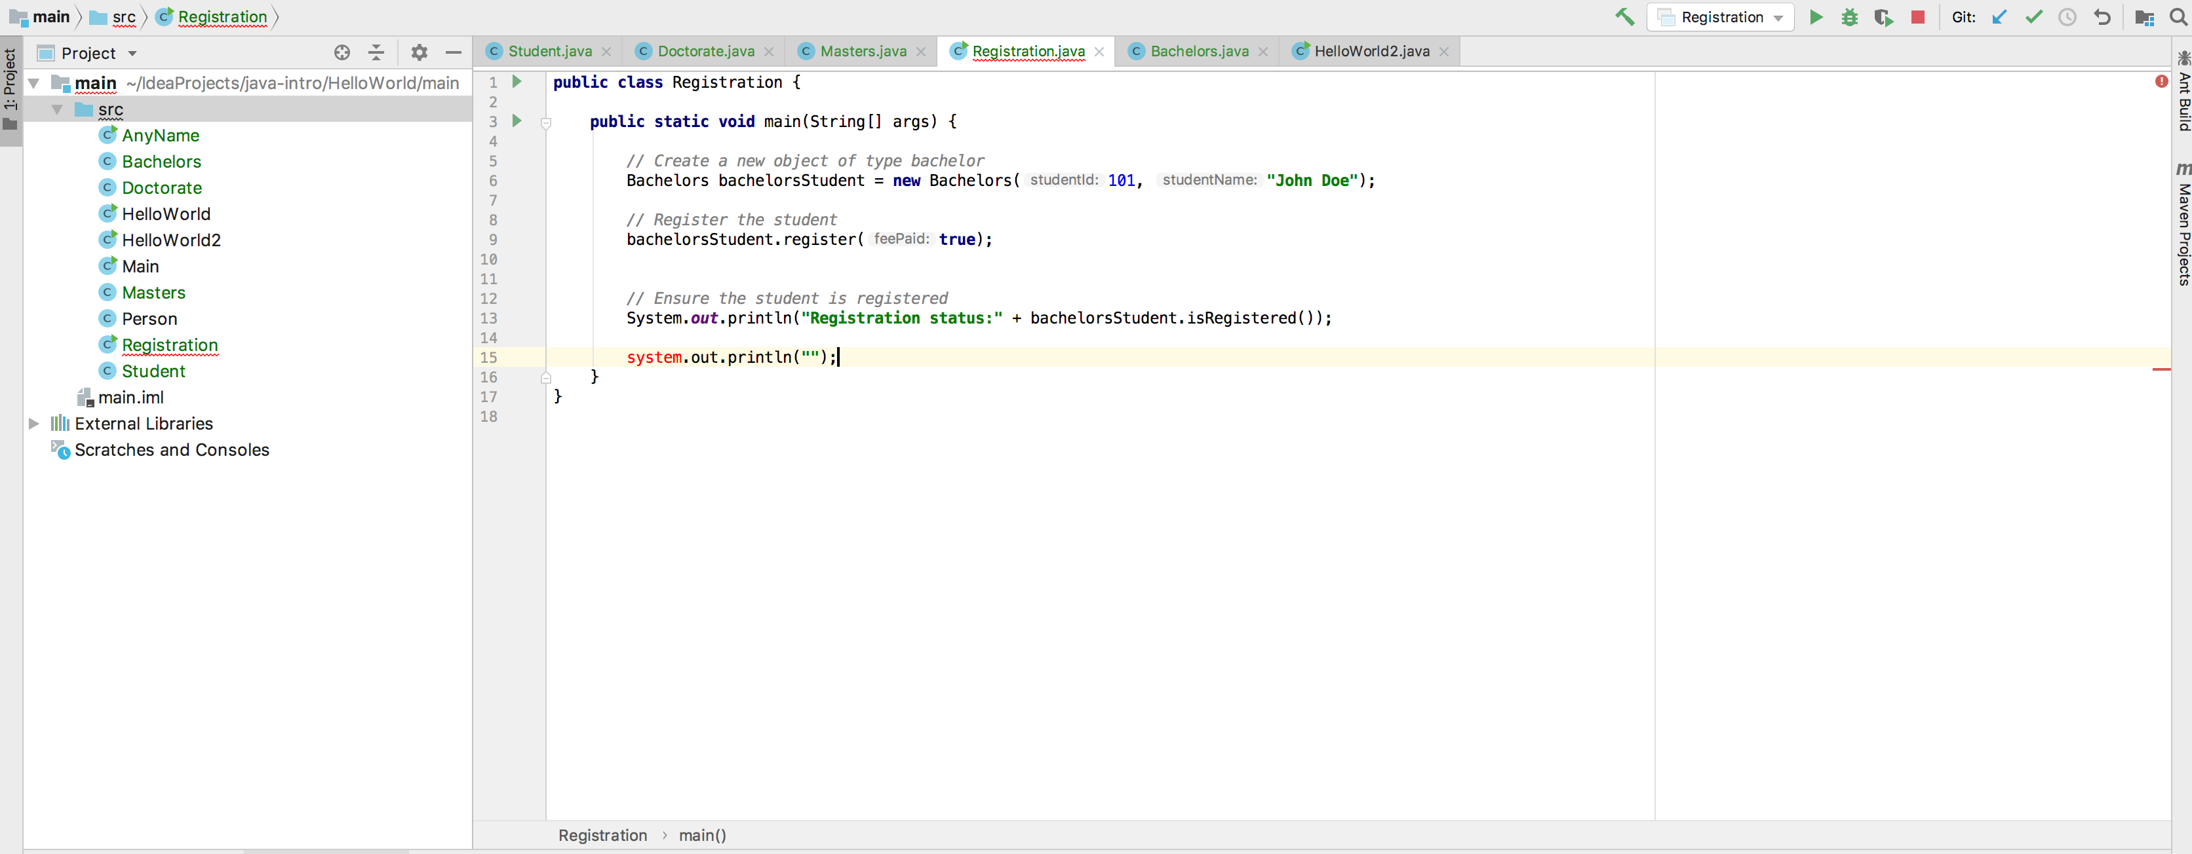
Debugging Syntax Errors
The IDE editor is your friend

Slide 12
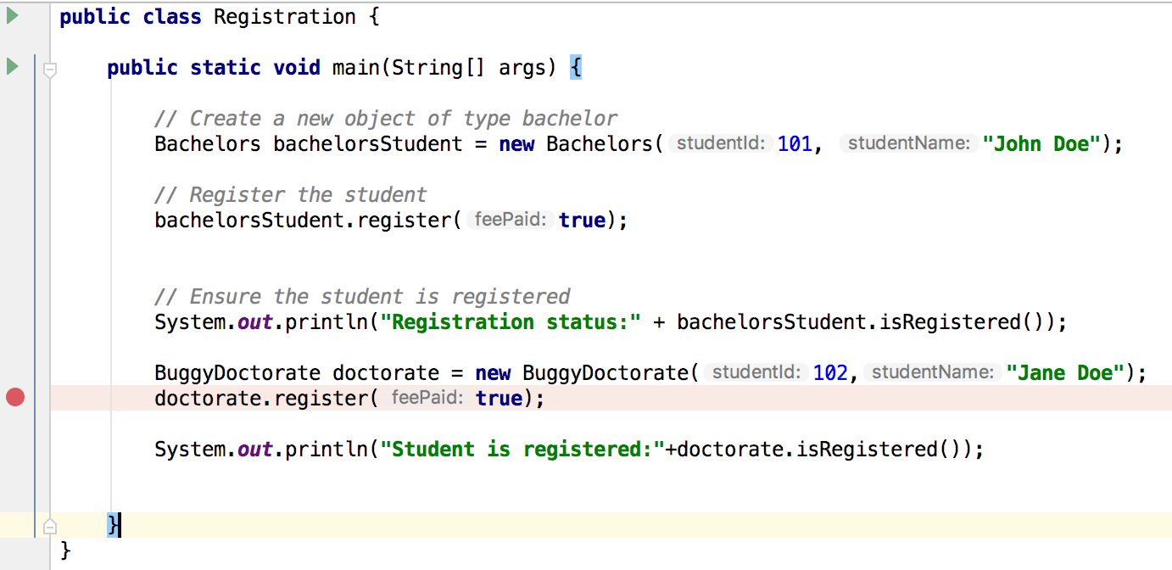
Debugging Logical Errors
The IDE debugger is your friend
Use line breaks to follow your code execution

Slide 13
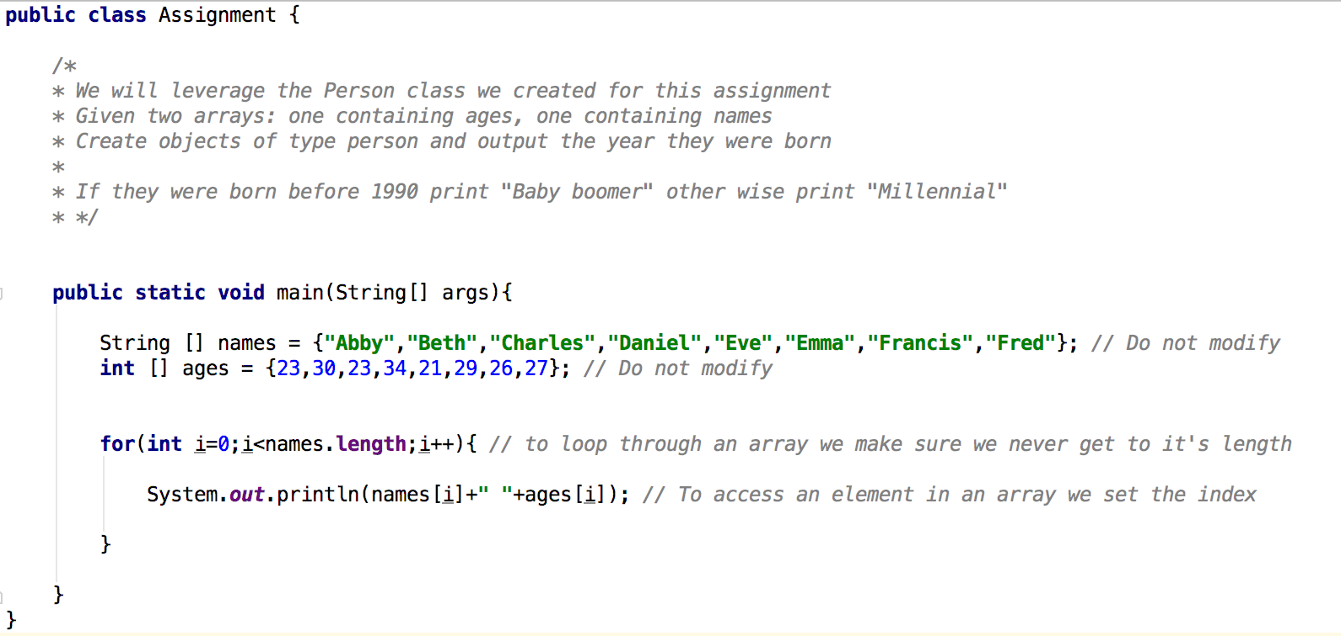
Assignment

Slide 14
To learn more
https://cosmolearning.org/courses/beginner-java-programming-tutorials-by-thenewboston/
https://developer.ibm.com/africa/new-collar/
Browse learning paths
Select Java

Slide 15
Contacts
Submit Your Assignment to:
Email: fbkwizera@ke.ibm.com

Slide 16
Thank You

